Slide 1
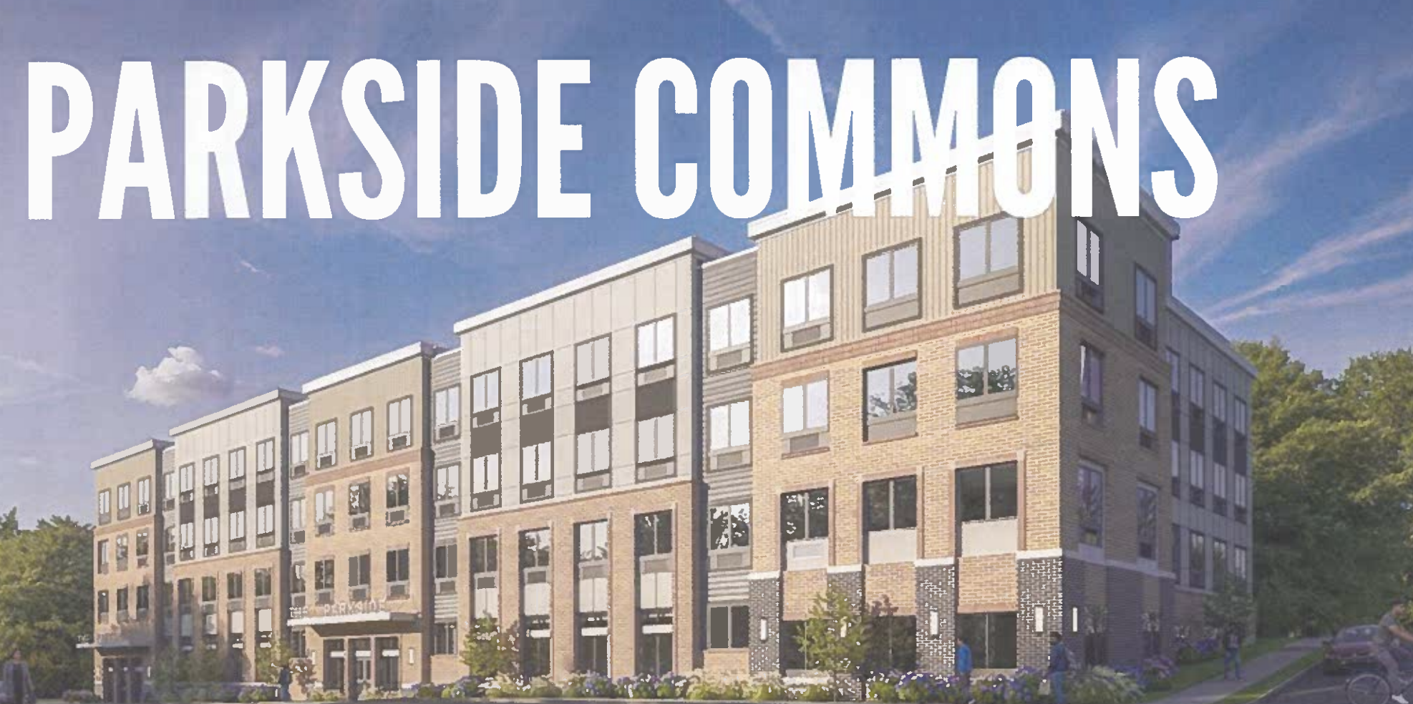

PARKSIDE
COMMONS
RESIDENT MEETING RELOCATION PLAN
August 27, 2026

Slide 2
Cathy Sims
Laurie Lindsey
Bilingual (Spanish) Relocation Specialists:
Lesvia Castro
Arnim Amador – Onsite
Calling/Texting: 📞 (866) 360-3515 Email: ✉️
csims@mitrelo.com
lcastro@mitrelo.com
aamador@mitrelo.com
l.lindsay@mitrelo.com
Website/Internet🌐: www.mitrelo.com
MIT RELOCATION TEAM
&
CONTACT INFORMATION

Slide 3
RESIDENT RELOCATION PLAN
Phased move plan for
Parkside Commons residents

Slide 4
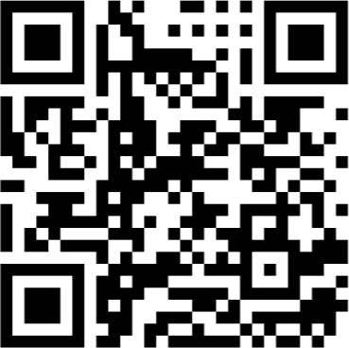
PHASE 1
PREPARATION
Ensure 100% compliance with Enviro Pest Control treatments and retreatments by providing support to property management with phone calls and notices to residents on an ongoing and continual basis since January 2026.
Conduct resident meetings to explain the process.
Resident Surveys need to be completed. Scan barcode
Perform resident assessments with Movers and Relocation team to identify contents of home and how many boxes and moving supplies will be needed.
Identify residents needing ADA-accessible units, relay shower grab bar requests to construction, and identify and document medical and special household needs.
How will I know it is my time to move?

Slide 5
RESIDENT NOTICES AND COMMUNICATION
All resident notices will be distributed in both English and Spanish to ensure clear communication with all households.
Residents will receive notices throughout the renovation and relocation process, so they are informed about upcoming activities affecting them individually and building-wide.
Assessment Notices
Residents were notified when the relocation team and representatives from the moving company were to visit their apartments.
The purpose of the visits:
The relocation team assessed the residents’ needs and followed up with individual relocation plans. During the visits, the residents asked questions and/or expressed any concerns that were addressed in the moment.
The moving company representatives assessed the apartments to determine the packing materials and moving services needed.
30-Day Relocation Notices
Residents will receive advance notice informing them that their relocation is approaching. This notice provides sufficient time for residents to prepare and to contact the relocation team with any questions or concerns.

Slide 6
Move Notices
Move notices will provide residents with the details of their relocation, including:
The unit they will be moving to
The scheduled date and time of the move
Instructions and expectations for moving day
Move notices will be issued for:
Temporary moves – Resident will move to another unit within the property during renovations.
Return moves – Resident will move to their original unit, if applicable at the time of move.
Moving Costs
No Cost to residents
General Building Notices
Additional notices will be provided throughout the renovation process to keep residents informed of building-related activities. These may include updates regarding:
Temporary water shutoffs
Temporary power interruptions
Elevator availability etc.
Notice Delivery and Resident Support
Notices will be hand-delivered to residents, and copies will also be available on Mit Relocation’s Website https://mitrelo.com/. Residents scheduled for relocation will be contacted directly by the relocation team to review the process, answer questions, and provide support
before, during, and after their move.

Slide 7
30-Day Notice
Temporary Unit Move Notice
Move Home Notice
Notices will be hand-delivered to residents. Residents scheduled for relocation will be contacted directly by the relocation team to review the process, answer questions, and provide support before, during, and after their move.
MIT NOTICES

Slide 8
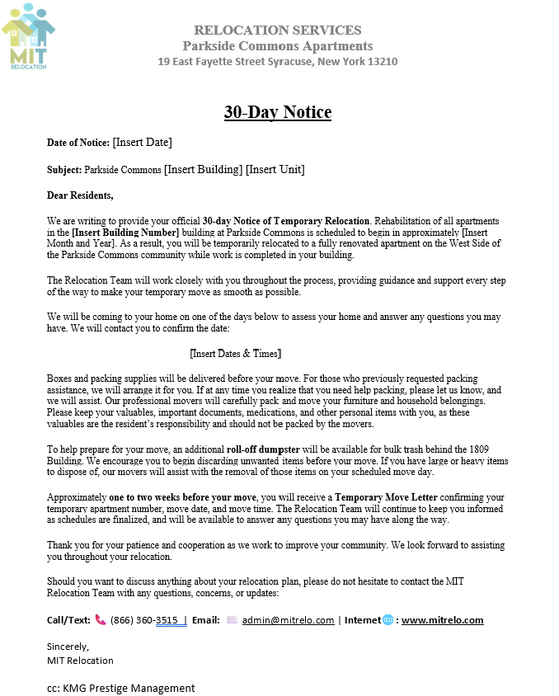
30-DAY NOTICE

Slide 9
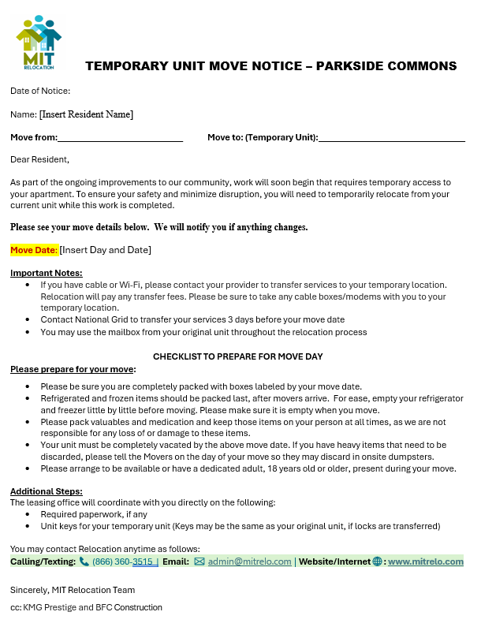
TEMPORARY UNIT
MOVE NOTICE

Slide 10
PHASE 2
MOVE-OUT
PREPARE FOR YOUR MOVE:
Start purging items that you are not planning to take with you, broken furniture, old clothing, old shoes no longer needed.
Dumpster will be provided on site for bulk items
MOVING DAY:
Residents communicate with movers bulk items to discard, fragile items, etc.
Support residents with final questions and issue resolution.
Relocation Move checklist completed.

Slide 11
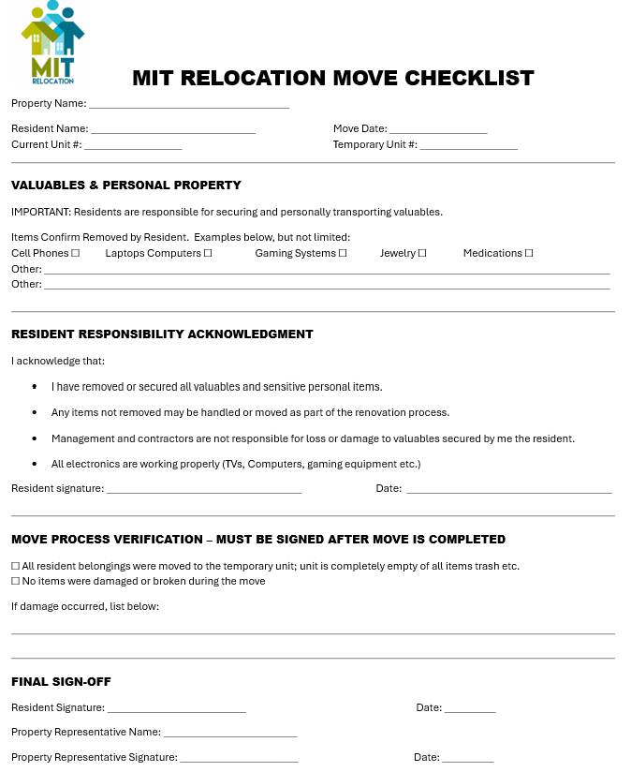
RELOCATION MOVE CHECKLIST

Slide 12
MOVE CREW
Licensed | Insured | Professional Moving Services
  On-time arrival, trained, courteous employees, and professional moving equipment
  Clear communication before and during moves
  Efficient loading, transport, and setup at destination
MOVE CREW
Movers You Can Depend On!

Slide 13
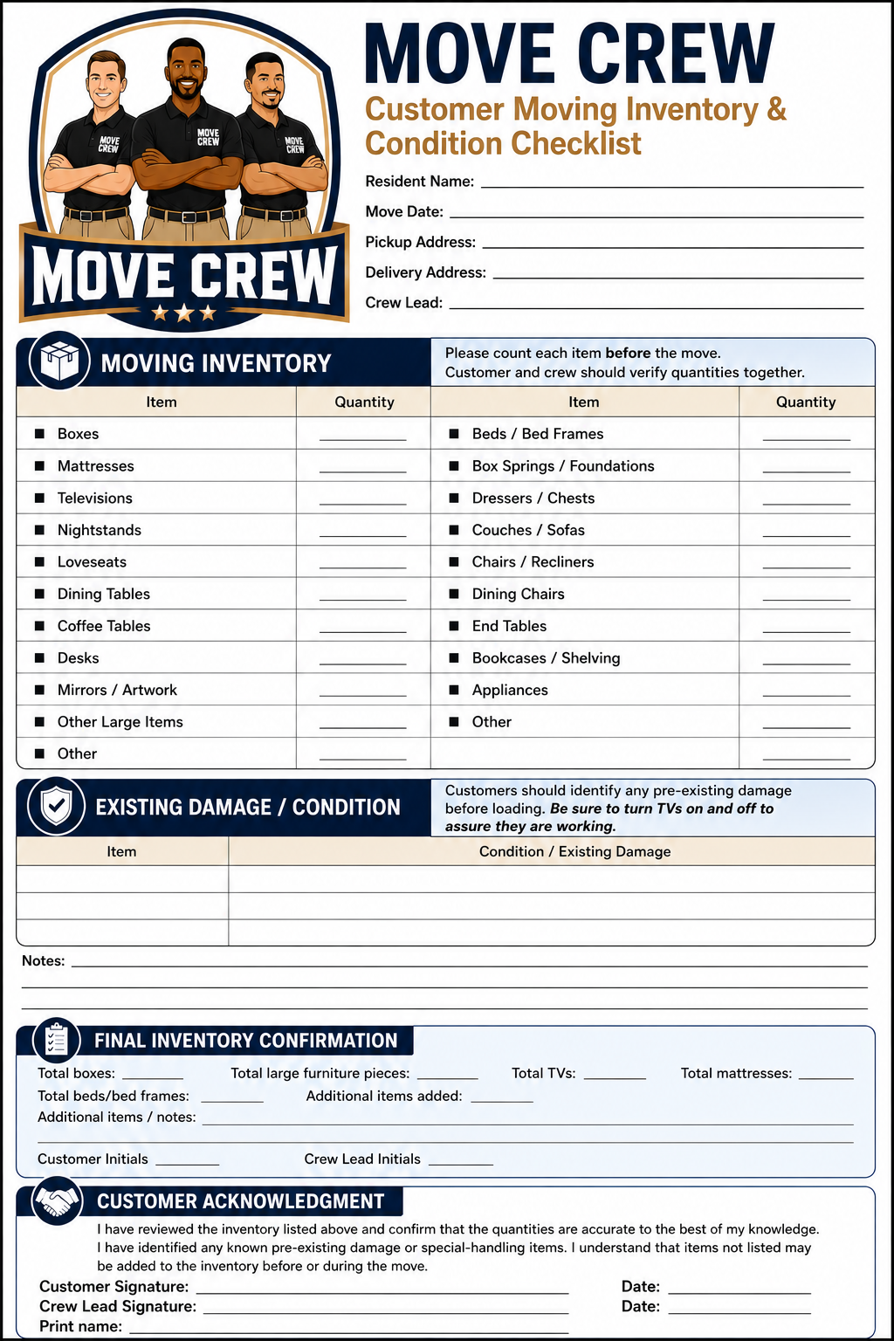
MOVE CREW
Customer Moving Inventory & Condition Checklist

Slide 14
Welcome residents to their permanent units with a Move Home Notice.
Confirm keys, utilities, and unit readiness.
Follow up after move-in to resolve concerns.
PHASE 3
MOVE-IN SUPPORT

Slide 15
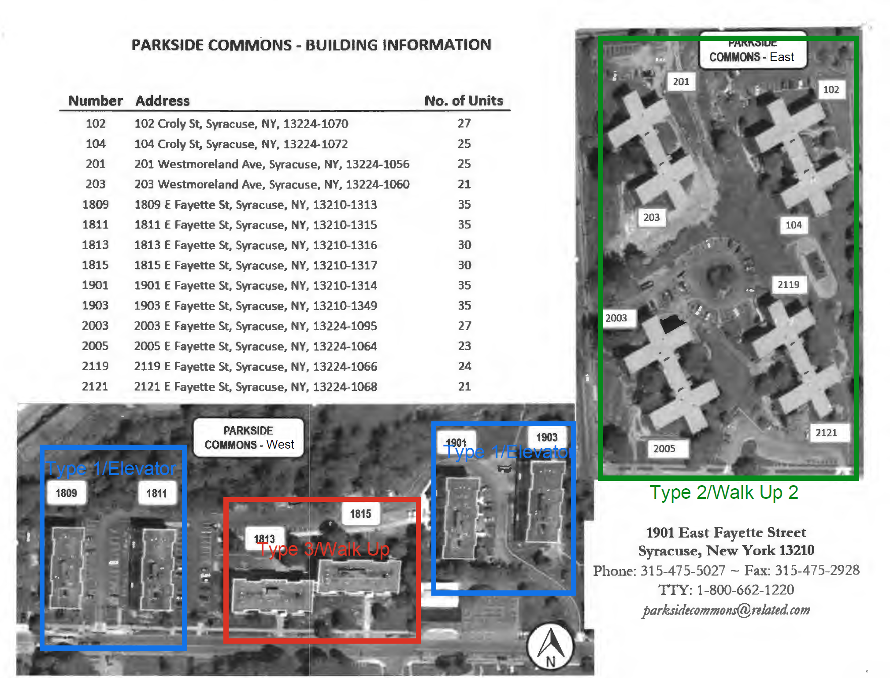
PARKSIDE COMMONS SITE REDEVELOPMENT MAP
EAST & WEST CAMPUS

Slide 16
Building 1809 residents move to renovated
23 scattered units.
Building 1809 is renovated.
Building 1811 moves out next and into 1809 temporarily. Then residents will move back home.
Next buildings move into temporary units and then go home.
The order of buildings moving next is as follows: 1901, 1903, 1813, and 1815.
BUILDING SEQUENCE

Slide 17
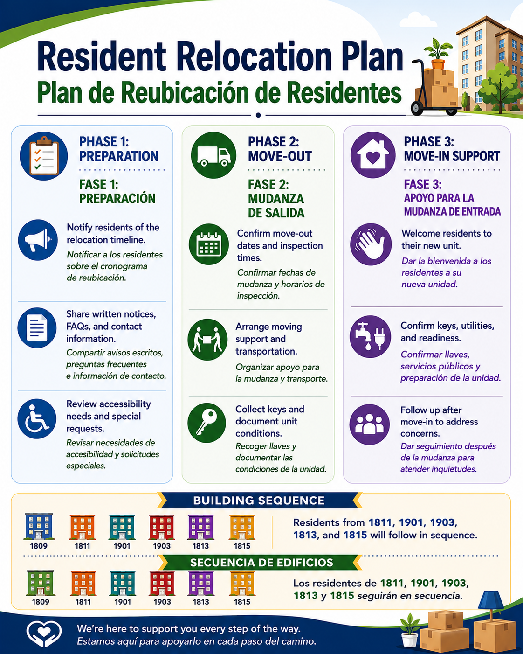
RELOCATION PLAN BILINGUAL FLYER FOR RESIDENTS

Slide 18
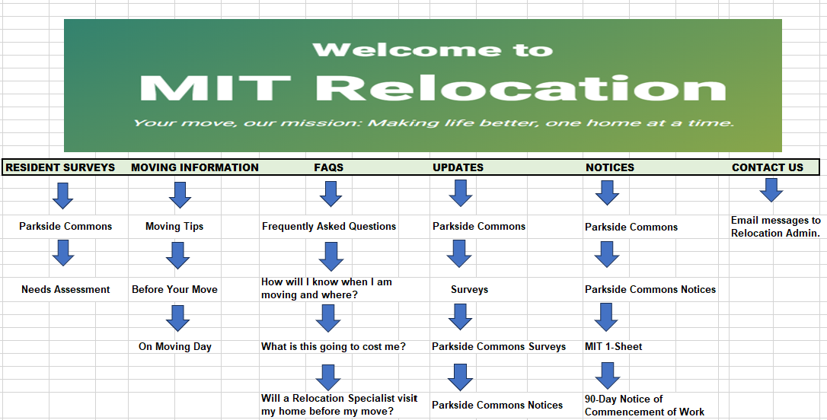
MIT
WEBSITE
🌐 www.mitrelo. com

Slide 19
Bilingual(Spanish) MIT Relocation Specialist, Lesvia Castro, and our on-site relocation specialist, Arnim Amador, are available to assist Spanish-speaking residents in answering questions throughout the renovation and project progress.
Our team is here to guide the residents, assist with property management and/or construction concerns, answer any questions, and help make all moves as smooth and as stress-free as possible throughout the project.
We are committed to clear communication and eﬃciency, from inception to completion of the Parkside Commons renovation project.
You may contact Relocation anytime via the following:
Call/Text : 📞 (866) 360-3515 | Email: ✉️ admin@mitrelo.com | Internet🌐: www.mitrelo.com

Slide 20
RESIDENT RESPONSIBILITY – IMPORTANT
EXTERIOR CAMERAS
All exterior Ring cameras must be removed before relocation. Residents are responsible for removing cameras and any exterior hardware not approved by Property Management.
PROPERTY MANAGEMENT
IMPORTANT UPDATES
LOCKS & DOOR HARDWARE
Deadbolt and secondary locks will not be transferred to renovated units. Please remove and retain them if you want to keep them. Secondary locks may be fire hazards and are considered a lease violation.
NO DOOR MODIFICATIONS
Residents may not install cameras, locks, deadbolts, or other door hardware in renovated units without prior approval from Property Management.
AIR-CONDITIONING UNITS
Existing resident-owned A/C units will be returned to the resident and will not be installed in the renovated unit because heating and cooling will be provided.
PERSONAL ITEMS
Resident must retain resident-owned items, and they are the resident’s responsibility to remove, retain, and/or store before renovation work. They will not be installed or transferred to the renovated unit unless specifically approved by Property Management.

Slide 21
CONSTRUCTION SCHEDULE
BUILDING BY BUILDING TIMELIME/PLAN
PARKSIDE COMMONS RENOVATIONS
10/26/26 – 11/5/27
Bldg. 1809 10/26/26 – 12/25/26
Bldg. 1811 12/28/26 – 2/26/27
Bldg. 1901 3/1/27 – 4/30/27
Bldg. 1903 5/3/27 – 7/2/27
Bldg. 1813 7/5/27 – 9/3/27
Bldg. 1815 9/6/27 – 11/5/27
BFC CONSTRUCTION

Slide 22
Q & A
MIT RELOCATION PRESENTATIONQ & A

